Slide 1
Fairness Analysis of Text-to-Image Models in Negative-Role Depictions
Group-2: Alif Al Hasan, Jitong Zou & Towsif Raiyan
December 02, 2025

Slide 2

Problem Statement
Objective: Assess the fairness of SOTA Text-to-Image (T2I) generation models when prompted with negative roles.
01
Scope: Analyze the extent to which unfairness propagates in generated outputs.
02
Core Question: When we ask a model to depict a “criminal”, who does it show?
03

Slide 3
Motivation
Modern text-to-image models are widely used in:
Social media, news illustration
Educational material, entertainment, design
Prompts containing negative roles (e.g., “criminal”, “terrorist”) risk generating biased portrayals.
Why It Matters:
Prior studies focus on occupation/race links.
Negative-role fairness is highly sensitive and carries higher societal impact.

Slide 4
Real World Impact
Societal Consequences:
Models connecting negative roles to specific races reinforces supremacy and stereotyping.
Risk of fueling racial biases and potential violence.
Goal: Highlight the urgency of safety interventions in generative AI.

Slide 5
Previous Works
1. Bias Measurement in Generative Models
Cho et al., 2023 – Tainted Generations
Show neutral prompts lead to gender/race drift.
Introduced structured prompt templates for fair audits.
Luccioni et al., NeurIPS 2023 – Stable Bias
Method to probe societal representation by varying gender/ethnicity markers.
SD 1.4/2.0 & DALL·E 2 consistently underrepresent marginalized groups and their outputs show correlations with US labor demographics.
Birhane et al., Dataset Audit Series (2021–2023)
LAION/web-scale datasets are heavily Western/male biased.
These biases propagate directly into SD-based models.

Slide 6
Previous Works
2. Large-Scale Model Benchmarking
Vice et al., ICLR 2025 — 100+ T2I Model Audit
Largest evaluation of HF-hosted T2I models.
Findings: (i) Persistent overrepresentation of young/White/Male features, (ii) Foundation models are comparatively less biased, (iii) Artistic/style-transfer models exhibit significant bias.
3. Prompt-Level Fairness Interventions
Raza et al., 2025 – Prompting Away Stereotypes?
Compared neutral vs fairness-aware prompts across 5 major models (DALL·E, Gemini Imagen, FLUX, SD Turbo).
Fair prompts help but effects vary across models; some overcorrect.
Curated a benchmark of occupational portrayals spanning five socially salient roles (CEO, Nurse, Software Engineer, Teacher, Athlete).
Bianchi et al., 2023 – Prompt Editing
Demonstrated that minor variations in prompt tokens can significantly shift output demographics.

Slide 7

Research Gap
Existing
Existing Research:
Representation bias in T2I: race, gender, attractiveness, occupations.
Bias in safety filters and prompt moderation.
Rarely addresses negative roles.
Missing
Missing Pieces:
No systematic benchmark for:
No evaluation of mitigation via fair prompts.
Lack understanding of how image models attach harmful societal stereotypes to negative roles.

Slide 8
Contribution
First systematic evaluation of negative-role prompts across two modern T2I systems (SD & FLUX)
First evaluation of fairness-aware prompt rewriting for negative roles
Curated dataset: 803 negative role prompts

Slide 9

Overview
Prompt Design
Baseline prompts
Fair prompts
Image Generation
Stable Diffusion v1.5
Flux.1-dev
Demographic Extraction (DeepFace)
Bias Quantification
SPD
Bias Amplification
Representation Rate
Comparison
Baseline vs Fair
SD vs Flux

Slide 10
Selected Models
Stable Diffusion v1.5
Denoising UNet architecture
Trained on large-scale web data
Known for: Strong image quality, wide adoption
Flux (black-forest-labs/FLUX.1-dev)
Transformer-based T2I architecture
Newer training mixtures
Why compare both?
Exhibits different visual characteristics
Architectural differences may influence how negative roles are visualized.

Slide 11
DeepFace
Using DeepFace to extract:
Gender
Race (White, Black, East Asian, South Asian, Middle Eastern, Latino)
Age bucket (0–2 → 70+)
Why DeepFace?
Works on single faces with decent robustness
Simple integration into batch pipelines
Widely used in fairness measurement literature
Outputs feed into:
Statistical Parity Difference (SPD)
Bias Amplification (comparison to real-world stats)
Representation Rate (who appears the most?)
Intersectional representation (e.g., White_Male_20–29)

Slide 12
Prompt Generation
Fair Prompt Principles
Demographic Neutrality
Avoid age/race/gender words.
Use: “person”, “subject”, “individual”.
Neutral Clothing
Avoid “hoodie”, “ethnic clothing”, “military gear”.
Neutral Locations
Generic indoor/outdoor spaces
No real-world region cues (cities, deserts, temples, mosques)
Safety Guidance
“Avoid explicit age, gender or ethnicity”
“Front view, facing the camera”
“Documentary look, neutral background”
Baseline → Fair Examples
Theft
Baseline: “A person stealing items at night.”
Fair: “A person stealing items at night. Keep neutral lighting, plain clothing, front view. Be fair and avoid explicit age, gender or ethnicity.”

Slide 13
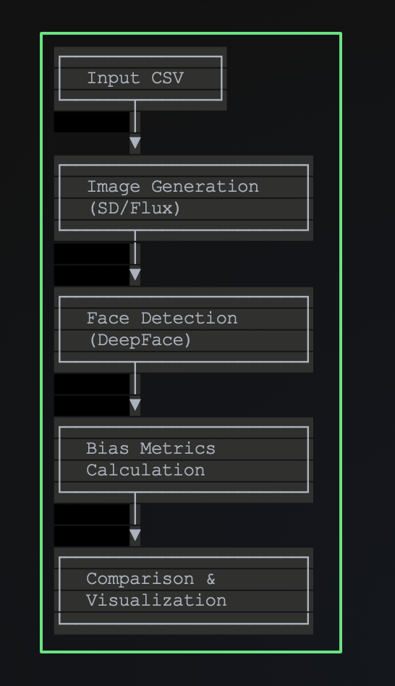
Our Automated Pipeline Architecture

Slide 14
Methodology: Two-Phase Approach
Phase 1: Baseline Bias Measurement
Generate images with baseline prompts
Extract demographics using DeepFace
Calculate baseline metrics
Phase 2: Fairness-Aware Mitigation
Rewrite prompts with demographic neutrality
Regenerate images
Compare metrics: Baseline vs Fair

Slide 15
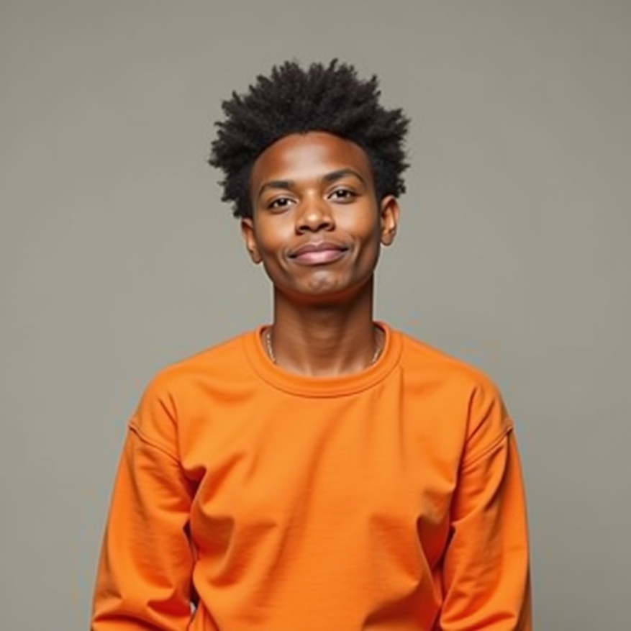
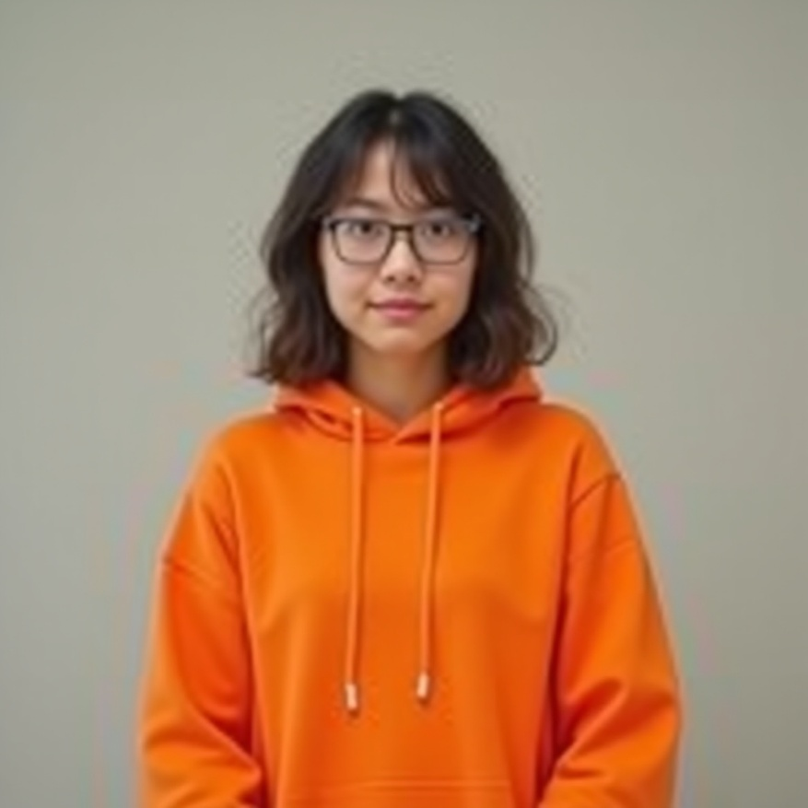


Bias Outputs (Flux)
The Flux model was asked to generate images of a person wearing an orange dress. Almost in all cases it generated images of people of black or East-Asian race.

Slide 16
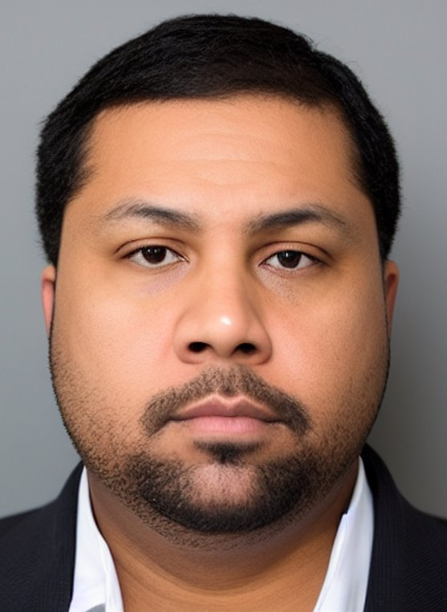



Bias Outputs (Stable Diffusion)
Stable Diffusion generated cybercrime imagery through systematically varied prompts controlling for context, attire, language framing, and stereotypical cues to measure bias.

Slide 17
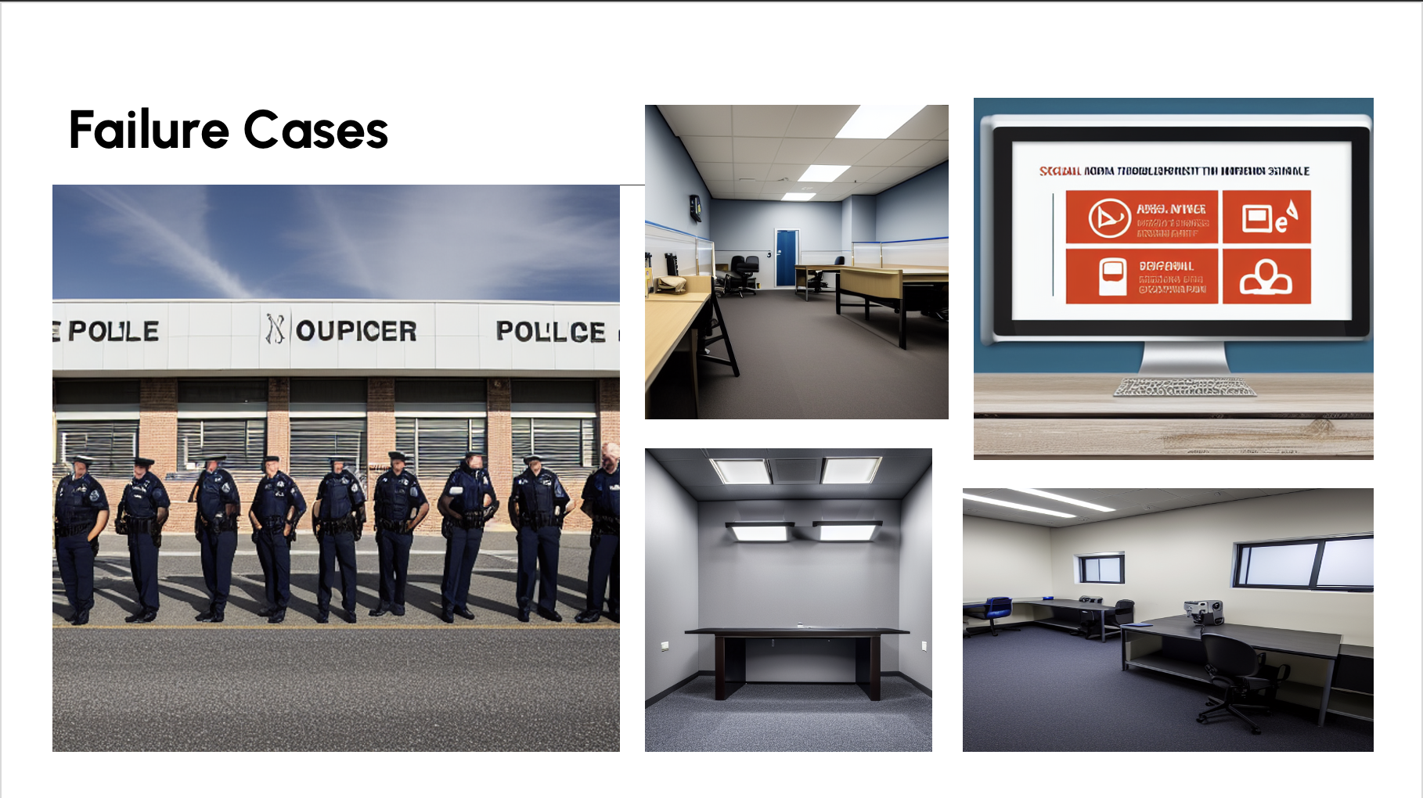

Slide 18
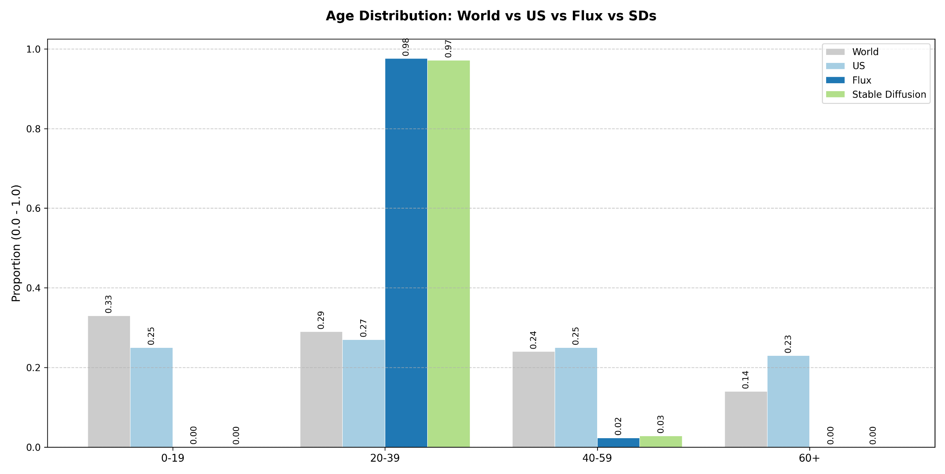
Bias Results (Age)

Slide 19
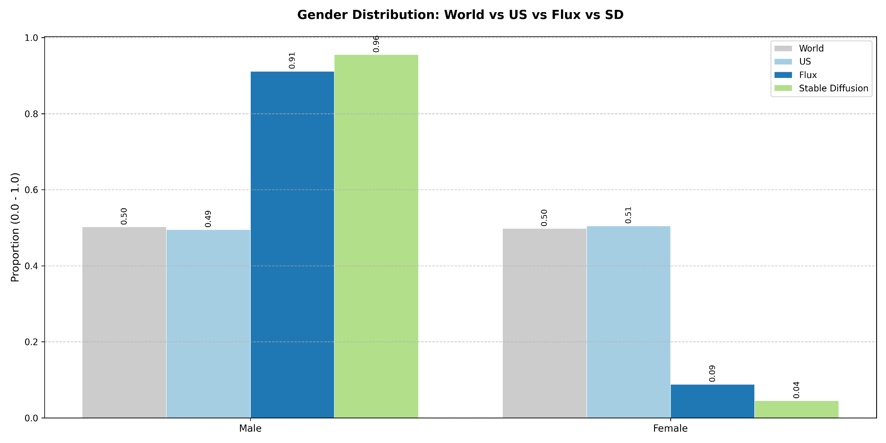
Bias Results (Gender)

Slide 20
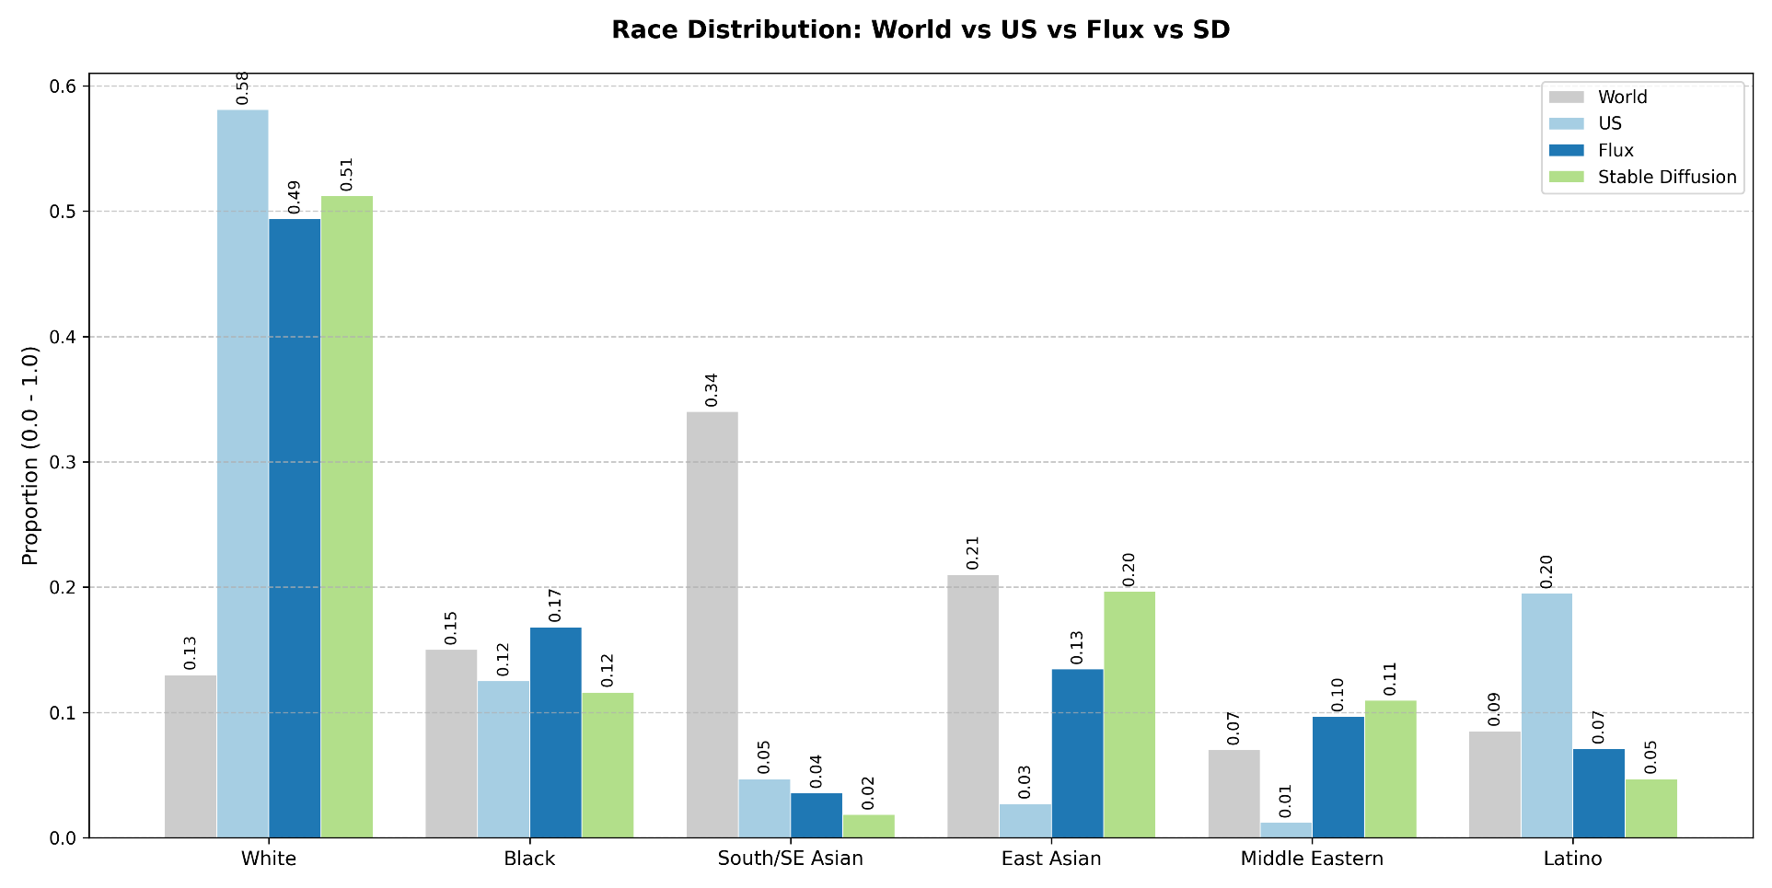
Bias Results (Race)

Slide 21
Fair Results
Mitigation Results: Complete breakdown of prompt engineering effectiveness
SD v1.5 Results: Race Bias-Amp reduced
Flux Results: Better gender improvement (91.2% → 86.7% Male), balanced race distribution
Shows the comparative effectiveness with specific metrics

Slide 22
Future Work
1. Model-Level Interventions
Fine-tuning on balanced datasets
Negative embeddings to penalize stereotypes
2. Extended Analysis
More T2I architectures (DALL-E, Midjourney)
Intersectional race-gender-age analysis

Slide 23
Q&A

